Slide 1
Education for Sustainability
EIPTN 2022 Athens
Caroline Coles, National Teacher Fellow
c.coles1@aston.ac.uk

Slide 2
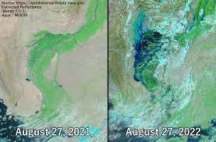
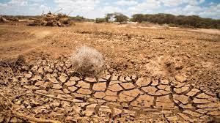
My Focus
Climate Change + Sustainable Development
The Challenge for HE: Education for Sustainable Development (Advance HE/QAA 2021)
Greece: The sixth national priority is “strengthening the protection and sustainable management of natural capital as a base for social prosperity”
Notes:
0.

Slide 3
General Challenge to us all
UNESCO 17 Sustainable Development Goals
European Patent Office
Carbon neutrality by 2030
Reviewing patent grant process
Managing process – use of digital, waste management
Harokopio University – policies and masters course on sustainable tourism; sustainable urban development

Slide 4
Effect on IP
Changing rights
Growth of Green Patents
Conceptual framework of our teaching:
IP successes
Engagement with business
Interdisciplinarity

Slide 5
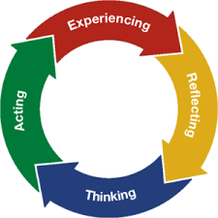
The Living Lab
Key principles
Open to innovation, empowerment
Stakeholder/ user/ student collaboration
Engagement, often practice based
Linked with learning frameworks
Interdisciplinary
Experiential learning (Lave & Wenger 1991)
Open Innovation (Chesborough, 2009)

Slide 6
Case Study 1: The Sports Club
SDG 13 Climate Action: premium on ticket price to fund tree planting schemes
SDG 12 Consumption: catering packaging
SDG 11 Communities: education schemes

Slide 7
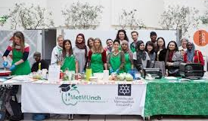
Case Study 2: The Vegan Café
Met Munch staff/student creation of vegan café on campus
Format for engagement –copyright, trade marks, recipes
SDG 12 Reasonable consumption . Nutritionist Haleh Moravei cooks and serves food within a lesson

Slide 8
What can we do : Build the Community
Students Organising for Sustainability UK (SOS)
Sustainability part of the @jiscmail.ac.uk community
Review ESD guidance from QAA/Advance HE
Policy of your own university
Build our links with business and other stakeholders and consider Living Lab

Slide 9
Further Examples
https://enoll.org/
https://enactus.org/
https://www.sos-uk.org/projects
https://www.aston.ac.uk/about/our-values/environment
Green Gown Awards
Sustainability in Sport
PRME Initiative

Slide 10
Sources
EPO . https://www.epo.org/about-us/office/social-responsibility/environment.html
Bergvall-Kareborn, B. & Stahlbrost, A. (2009) Living Lab. International Journal of Innovation &Regional Development
Graczyk, P. (2015) Embedding a Living Lab Approach at the University of Edinburgh. Edinburgh: The University of Edinburgh.
Lave, J. & Wenger, E. (1991) Situated learning: Legitimate peripheral participation. Cambridge: Cambridge University Press

